Slide 1

Webinar: OGC API - Common and OGC API - Features Sprint|
Gobe Hobona
September 23rd, 2020
#OGCAPI
Sprint Sponsored by

Slide 2
Agenda
Welcome - Gobe Hobona (OGC)
Sponsor Remarks – Peter Parslow (Ordnance Survey)
OGC API - Common - Part 2: Geospatial Data draft specification – Chuck Heazel (Heazel Tech)
OGC API - Features - Part 4: Simple Transactions - Panagiotis 'Peter' A. Vretanos (CubeWerx)
API Security Considerations – Andreas Matheus (Secure Dimensions)
Questions & Answers

Slide 5
Welcome
OGC invites you to the OGC API September 2020 Code Sprint, to be held virtually on:
Day 1: Tuesday 29 September from 09:00am to 05:30pm EDT.
Day 2: Wednesday 30 September from 09:00am to 05:00pm EDT.
What is an OGC Code Sprint?
A collaborative and inclusive event driven by innovative and rapid programming with minimum process and organization constraints to support the development of new applications and open standards.

Slide 6
Motivation
The increasing need for interoperability between Web APIs
The growing uptake of location within non-traditional geospatial developer communities

Slide 7

Sponsor’s Remarks

Slide 8
Overview of the draft specification
OGC API - Common

Slide 9
Overview of the draft specification
OGC API - Features

Slide 10
Overview of topic
API Security Considerations

Slide 11
Sprint Description
The scope of the code sprint is to include:
Specification development
API implementation and testing, using OpenAPI 3.0
Participants are welcome to bring partial or complete implementations of servers or clients to support the sprint.
Participants will have the opportunity to experiment with parts of the specification and develop working services.

Slide 12
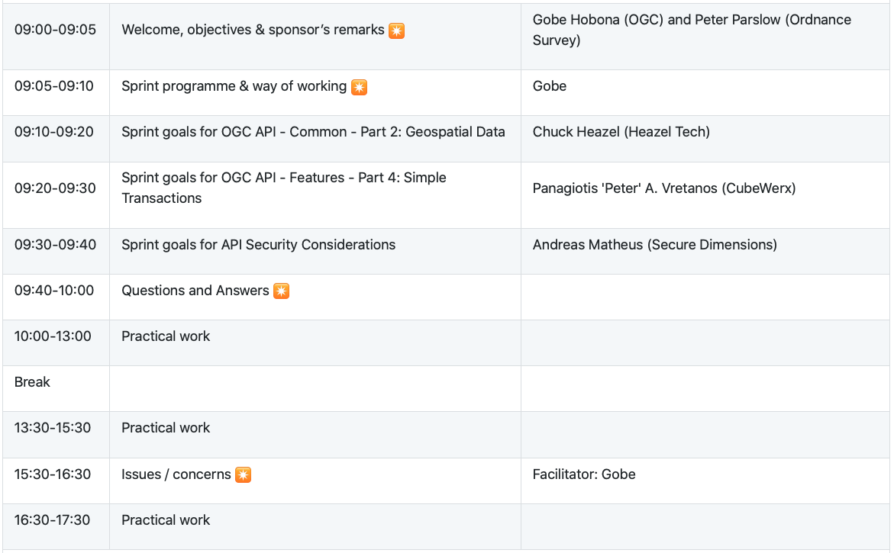
Sprint Schedule: September 29th, 2020

Slide 13
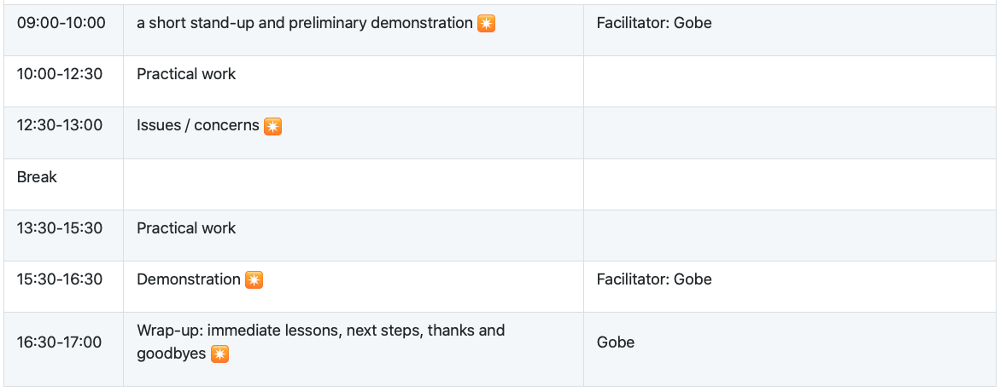
Sprint Schedule: September 30th, 2020

Slide 14
Logistics
Gotomeeting
Link to be provided to registered participants only.
Gitter
https://gitter.im/opengeospatial/OGC-API-Sprint-September-2020
GitHub
Sprint repo https://github.com/opengeospatial/OGC-API-Sprint-September-2020

Slide 15
Cost-Share Funding
Without commitment, there may be some funding available for participants to offset their labor costs. Below are the details.
The application form for the potential cost-share funding is at https://docs.google.com/forms/d/1XYEXlgMp3ascx99TGKnvMfukg1ktAlo7jC5YBN-TzD0/viewform
To be eligible for the funding, the participants:
must be OGC Members in good standing.
must have registered to participate in the sprint before 09:00am EDT on September 29th , 2020.
must spend at least 16 hours participating in the sprint during the two-day sprint
must complete and submit an application for cost-share funding before 05:00pm EDT on October 2nd, 2020
Note that applying for the funding is not a guarantee that any funding will be provided. OGC will calculate the funding to award based on the number of applications received.

Slide 16
Community
500+ International Members
110+ Member Meetings
60+ Alliance and Liaison partners
50+ Standards Working Groups
45+ Domain Working Groups
25+ Years of Not for Profit Work 10+ Regional and Country Forums
Innovation
120+ Innovation Initiatives
380+ Technical reports
Quarterly Tech Trends monitoring
Standards
65+ Adopted Standards
300+ products with 1000+ certified implementations
1,700,000+ Operational Data Sets Using OGC Standards
Contact info@ogc.org to schedule a meeting for an in-depth discussion with OGC staff and join our community today!
Notes:
If you have any questions, do not hesitate to reach out to OGC or schedule a follow-up. We’re working constantly to change the landscape of location information and want to help your organization get where it needs to go.

